Slide 1
Principal of Design

Slide 2
Site Map
A site map is a model of a website's content designed to help both users and search engines navigate the site.
A site map can be a hierarchical list of pages (with links) organized by topic, an organization chart, or an XML document that provides instructions to search engine crawl bots.

Slide 3
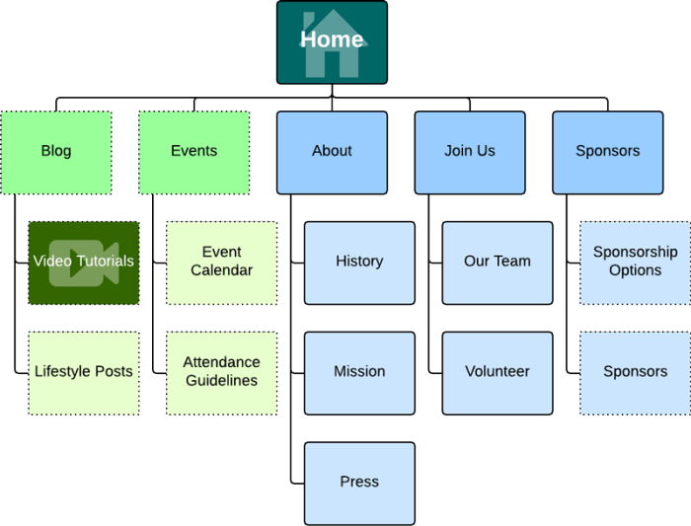
Example

Slide 4
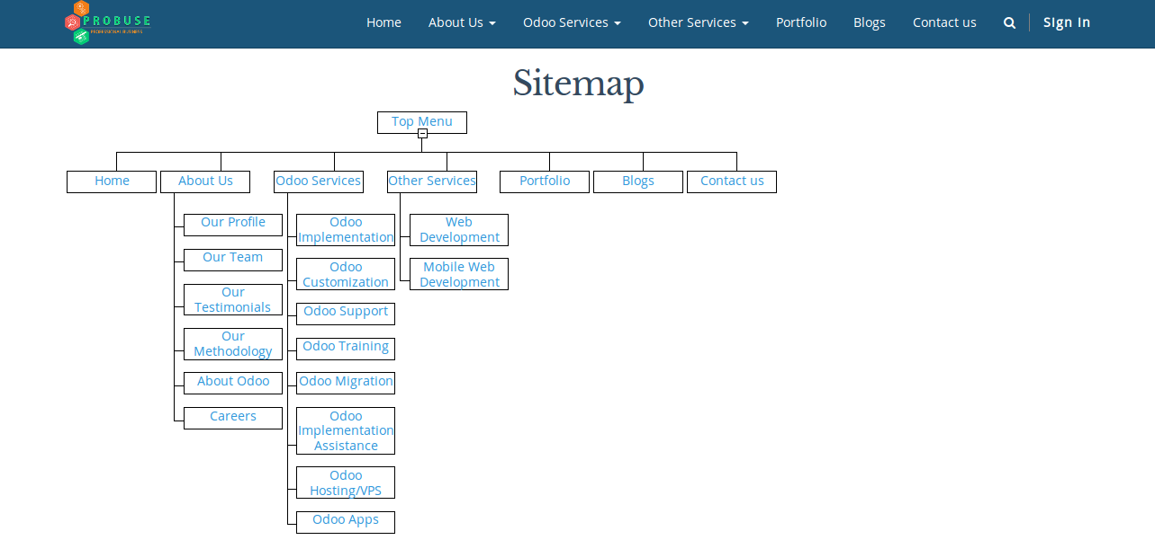
Sitemap

Slide 5
Try to create a site map for vision college website using word processer

Slide 6
How to make a beautiful website
Less is More – Simplicity Rules, clean, fresh design make the site easier to navigate, aesthetics (idea of beauty), more appealing and will stand the test of time.
Innovative (Not distracting)
Aesthetically appealing to right users
Respectful honest and engaging
Designed for Usability and Functionality
Cohesive in Design, Down to the Details
Easy to understand
Inspiring design elements
Visual elements placed to focus user attention
Emphasis on what matters first

Slide 7
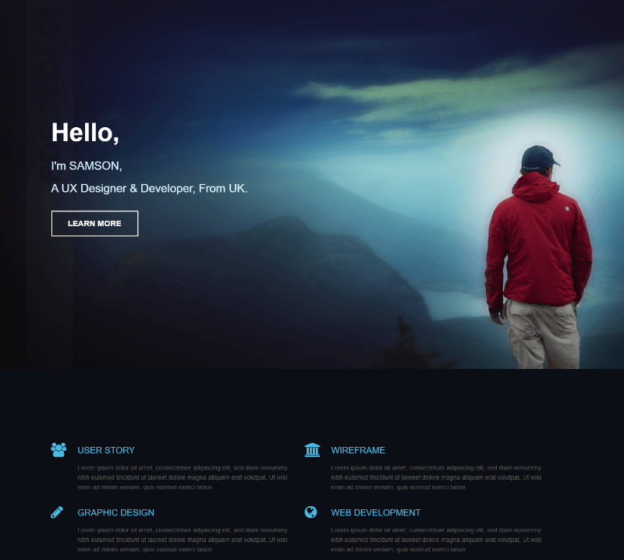
Example

Slide 8
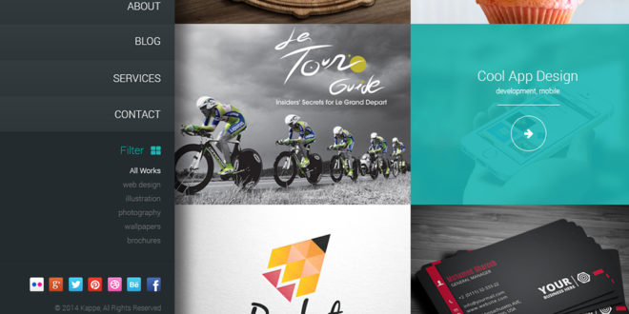

Slide 9
Some of the best website examples
https://blog.hubspot.com/marketing/best-website-designs-list
https://www.awwwards.com/

Slide 10
Principles of website design
Unity
Negative spaces
Repetition
Overlapping
Contrast
Texture
Balance
Alignment
Grouping
Emphasis

Slide 11

“The whole is other than the sum of the parts.” — Kurt Koffka

Slide 12

In the left image above, you should see a white triangle even though the image is actually comprised of three black Pac-Man-like shapes. On the right image, you see a panda even though the figure is several random shapes. Seeing the triangle and panda is simpler than trying to make sense of the individual parts.

Slide 13
Unity
Unity. It’s a very important concept in design and one that is actually pretty easy to achieve.
Unity is simply that, the unification of objects within a composition.
Unity is the measure of how objects or elements fit together — or don’t for that matter. Its really just a matter of linking elements together to create harmony. This harmony in elements can be accomplished through:
The physical proximity of elements
The repetition of elements or the repetition of element attributes
The continuation of lines and edges within a design — how elements align and group together

Slide 14

Legos are like Unity.
By itself a Lego piece may not do or mean much but when combined with other Legos you can build really awesome stuff, and you can always re-use the single pieces to construct other things — each piece is universal but when unified become unique.
Same goes for web design: each element, image, paragraph, navigation, logo, footer, links, by itself is not very meaningful, but when combined together the correct way can create a very powerful tool.

Slide 15
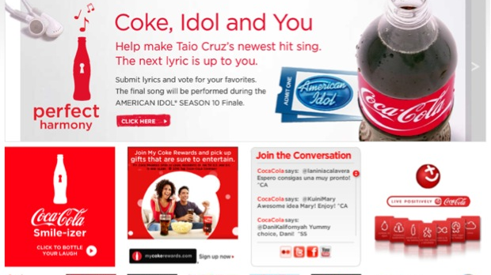

Slide 16
https://www.wix.com/website-template/view/html/2146?siteId=d0848446-fdb8-4ebd-ba9b-0320583dbb80&metaSiteId=84a360bb-a383-49fc-a5b9-da678ce2386c&originUrl=https%3A%2F%2Fwww.wix.com%2Fwebsite%2Ftemplates%2Fhtml%2Fhealth-wellness

Slide 17
Space
Design is an arrangement of both shapes and space. To work more effectively with space, you must first become aware of it and learn to see it — learn to see the shapes that space forms
Think about music for a moment. If every note or chord were played at the same time, you wouldn’t have music. You’d have noise. Music occurs when sounds are contrasted against silence. Varying the pattern of sound and silence creates rhythm and melody. Without the silence, there is no music.
Space performs the same function visually. It gives positive elements room to breathe. It gives the eye freedom to move through a design and to discover the elements it’s looking for. The positive is seen only in contrast with the negative. Without space, you don’t have design. You have visual noise.

Slide 18
establish contrast, emphasis and hierarchy;
generate drama and tension;
provide visual rest between groups of elements.
to improve readability and legibility. Macro-space makes text more inviting. Micro-space makes it more legible.
Micro-space. This is space within elements in a group. It’s the space between letters, words and paragraphs.
Macro-space. This is space between major elements. It separate elements or groups of elements and provides avenues for the eye to follow and places to rest between elements.

Slide 19
Space can also convey attributes other than quality, such as:
sophistication,
simplicity,
luxury,
cleanliness,
solitude,
Openness
You waste space when you fail to consider it. You can waste space by overfilling it. You can waste space by trapping it inside elements of a design and not allowing it to connect to other space in the design.

Slide 20
The space at the top of Introducing the Novel is asymmetric and active.
Thin light lines are also used to group and separate these blocks. When viewing the website, notice how the lines don’t always touch, allowing the space to flow around them and connect to other space. This prevents the space from being trapped
Don’t be afraid to use space

Slide 21
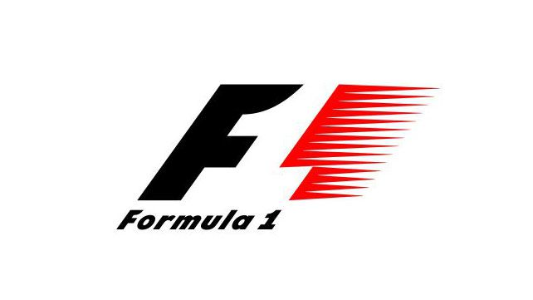

Slide 22


Slide 23
Repetition
Easy way to promote unity in a web design is to repeat colours, shapes, textures or other patterns between elements and objects on the page
The best way to use repetition is by simply pushing elements such as titles, spacing, and graphics, just a little further. Be bold! Be dramatic! Try new ideas, experiment, and see what you can come up with.
You can also achieve repetition by using repeated messages. If you want your customers to know that you’re the cheapest or the fastest in the business, you’ll want to tell them that on more than one occasion if you want the message to stick. In this instance, we use repetition for reinforcement.
Avoid repeating elements to the point where they becomes overwhelming and irritating. If they detract from the content, they are too much. Repetition should help people focus on your content, not repel them. Sometimes it is best to ask another person's opinion to make sure you have the right balance

Slide 24
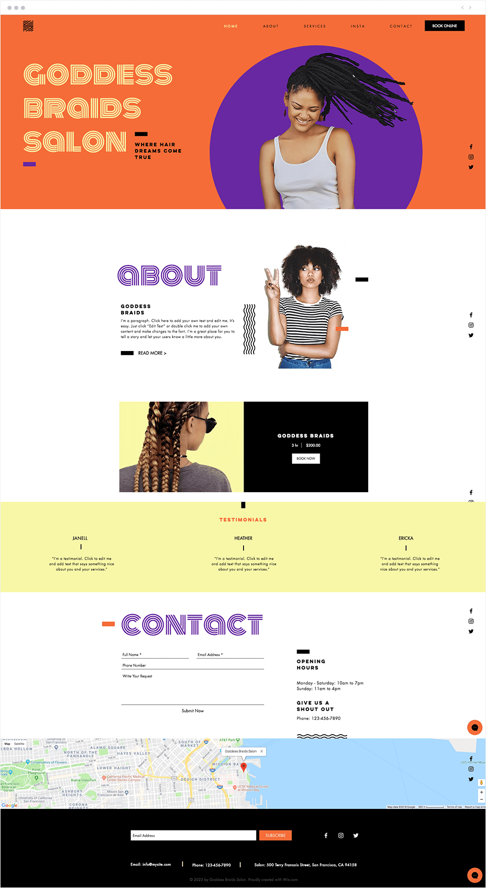

Slide 25
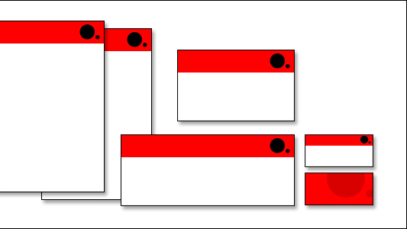

Slide 26
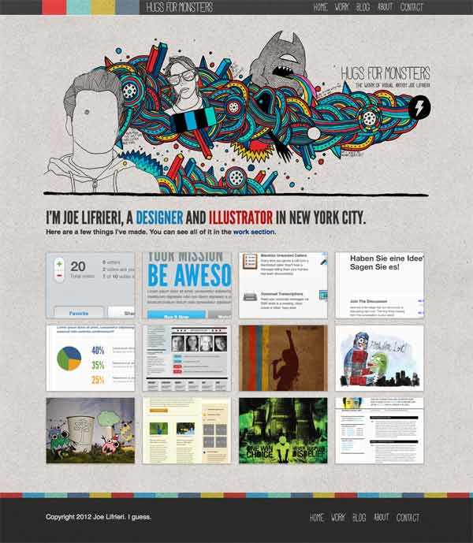

Slide 27
Overlapping
As elements overlap or touch, the top layer typically gets the primary attention.
However the overlapping object suddenly becomes overshadowed if the other objects close by are in stark contrast;
as objects become closer together the contrasting elements will stand out.

Slide 28
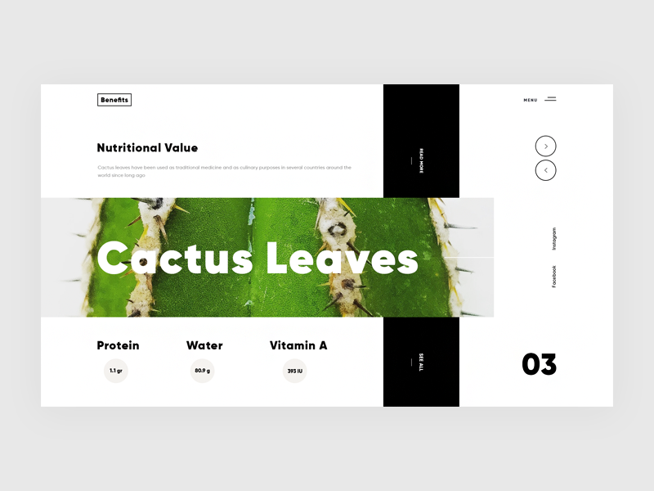
Overlapping

Slide 29
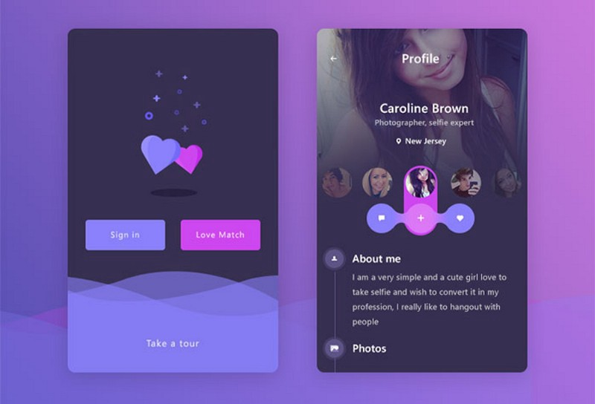

Slide 30
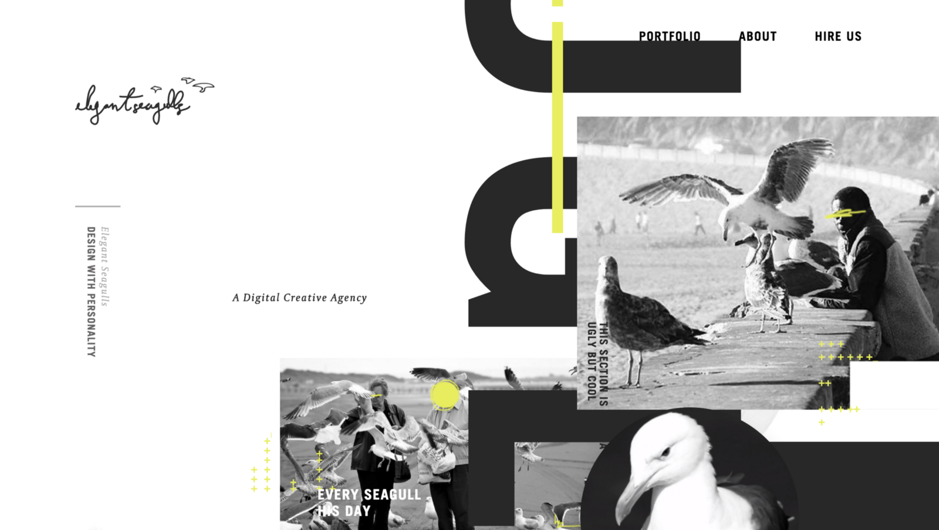

Slide 31
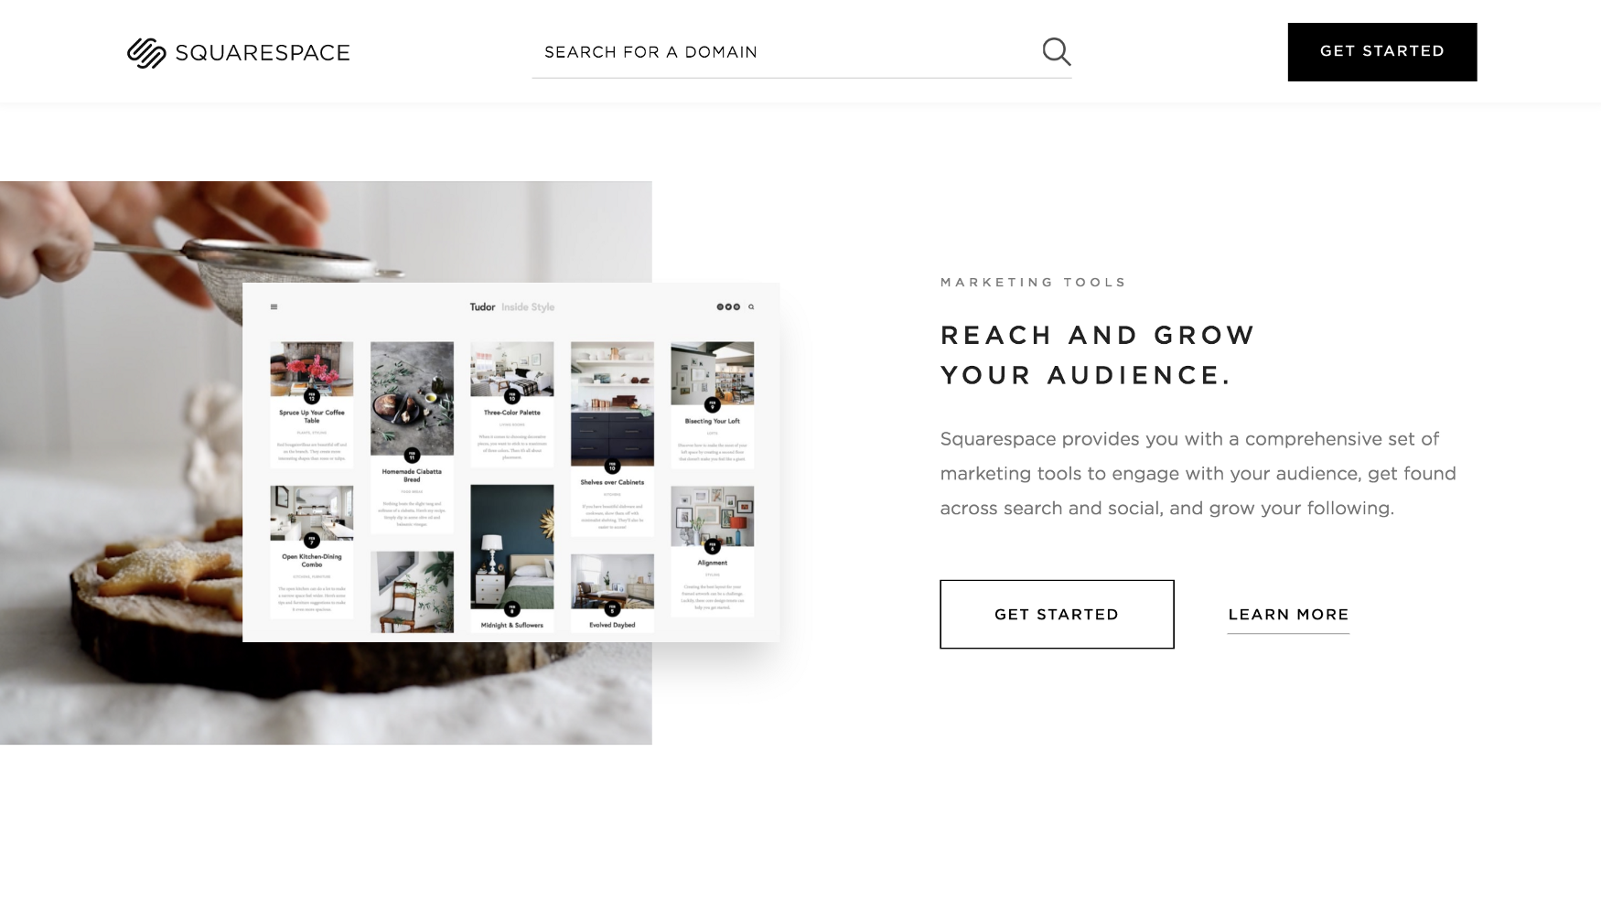

Slide 32
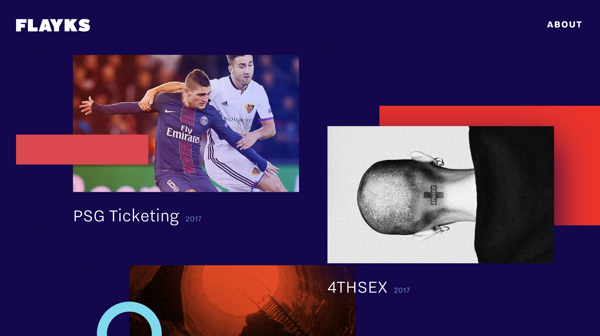

Slide 33
Contrast
Contrast allows you to emphasize or highlight key elements within your design.
Contrast is created when two elements are total opposites.
This doesn’t necessarily have to be colours either.
It can be achieved with fonts (classic/contemporary), lines (thick/thin) and shapes (big/small), just to name a few.

Slide 34
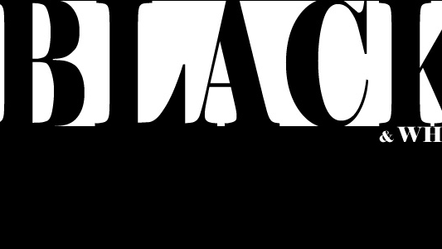

Slide 35


Slide 36
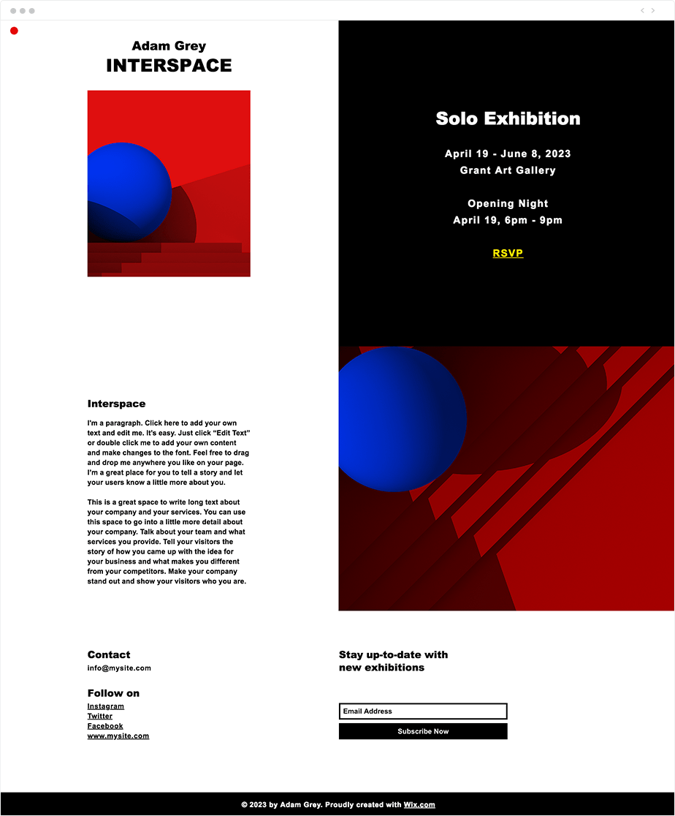

Slide 37
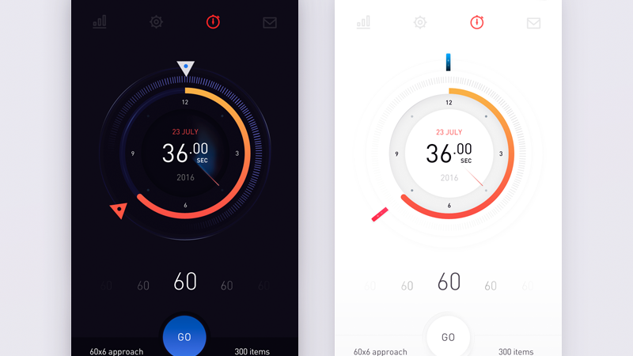

Slide 38
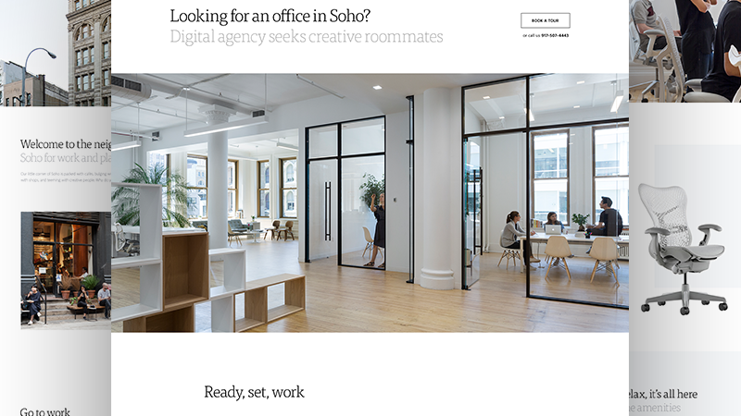

Slide 39
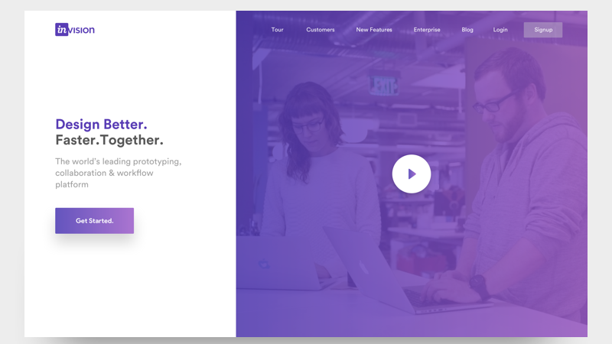

Slide 40
Texture
Texture refers to the surface quality in a work of art.
We associate textures with the way that things look or feel.
Everything has some type of texture.
We describe things as being rough, smooth, silky, shiny, fuzzy and so on.

Slide 41
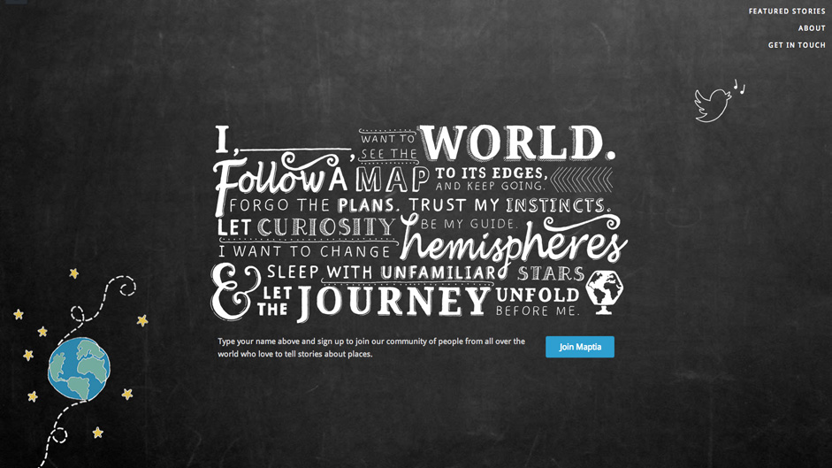
Texture

Slide 42
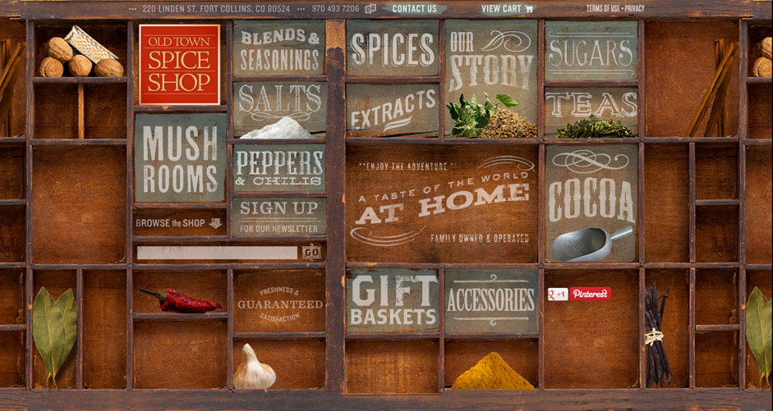

Slide 43
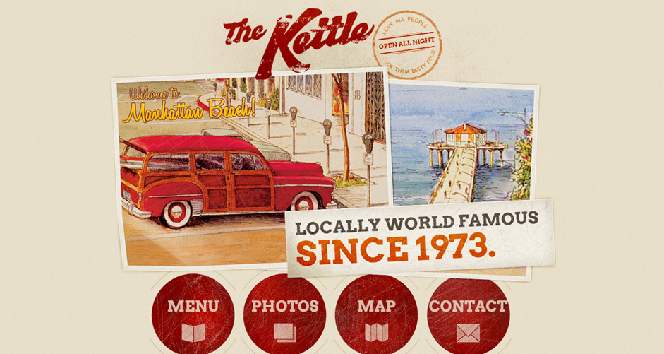

Slide 44
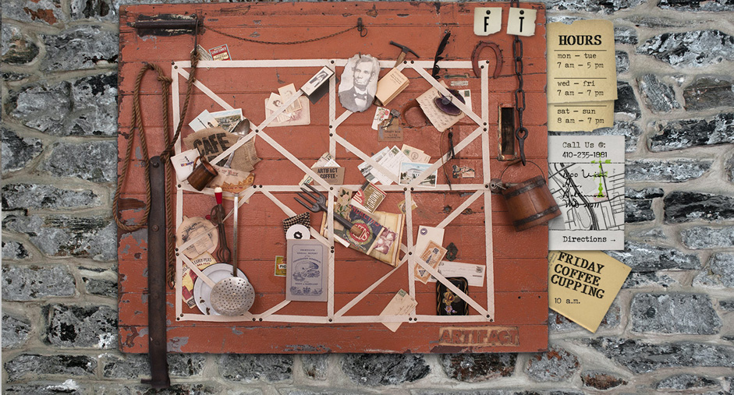

Slide 45


Slide 46
Balance
Finding balance seems to be the key to good fortunes, stability, professional happiness… and artistic compositions.
In design terms, balance is making sure that no single element overpowers another, thereby causing the other items to dwindle insignificantly into the background and serve no purpose.
There are three types of balance to choose from:
Symmetrical balance: Picture a line of symmetry. This type of balance occurs when one side is a mirror image of the other, like a butterfly.
Asymmetrical balance: Also using a line as your focus point, this occurs when features are not exactly the same on both sides but have the same visual ‘weight.’
Radial balance: Everything is focused around a central point, rather than a line.

Slide 47
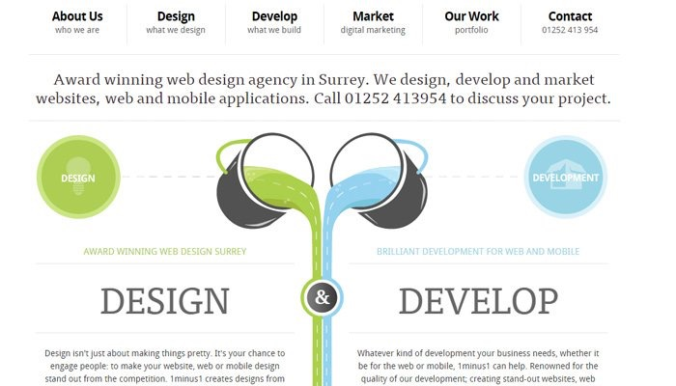

Slide 48
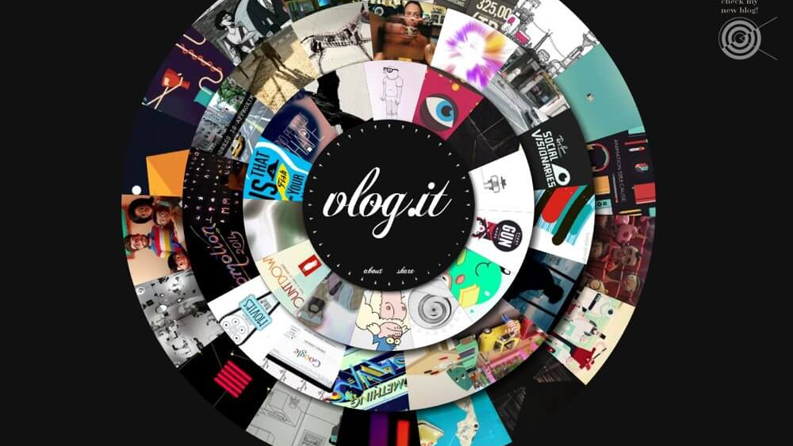

Slide 49
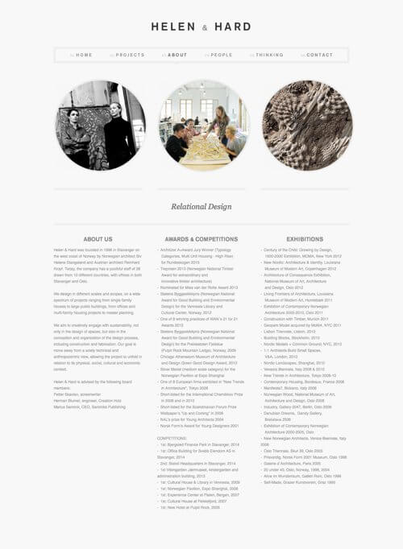

Slide 50
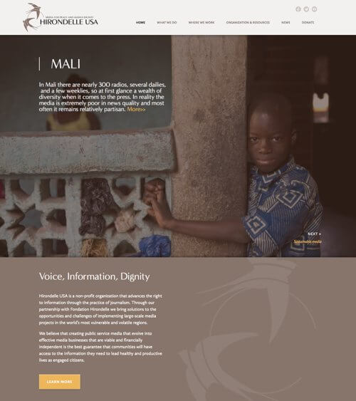

Slide 51
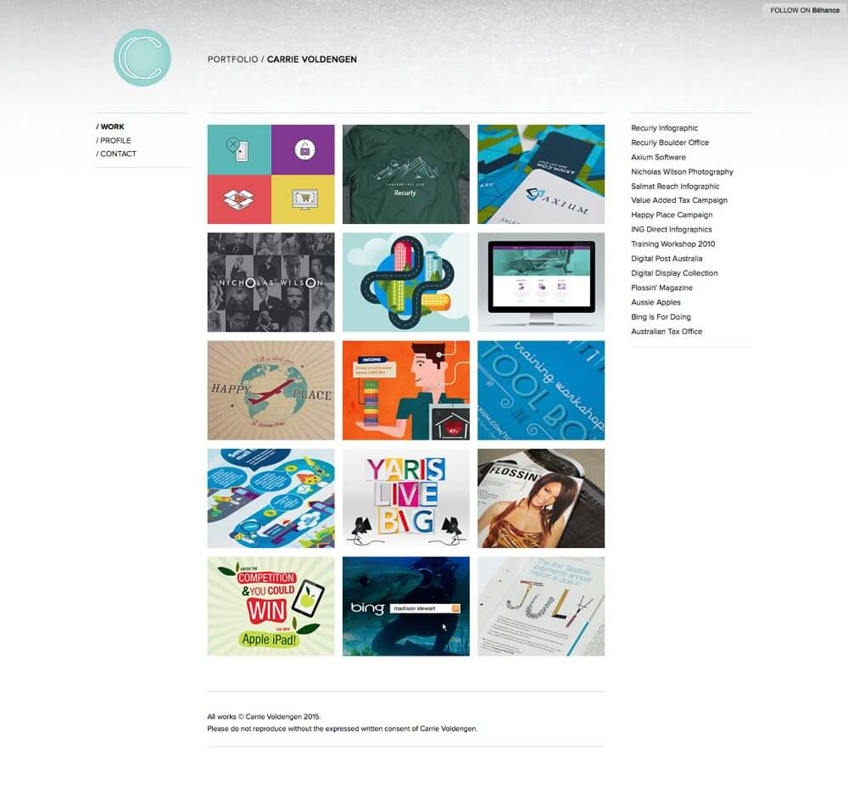

Slide 52
Alignment
Alignment is one of those things that comes hand-in-hand when working with grid systems.
The subject of alignment isn’t simply a matter of choosing whether or not you want to align text or images to the left or right of a design (though those decisions obviously still matter), instead, we employ alignment to improve our designs.
Proper alignment in your designs will make them visually more appealing and will also make it easier for users to scan over a page, sub-consciously also offering a calmer reading experience.

Slide 53
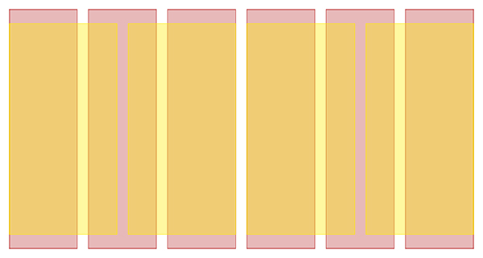

Slide 54
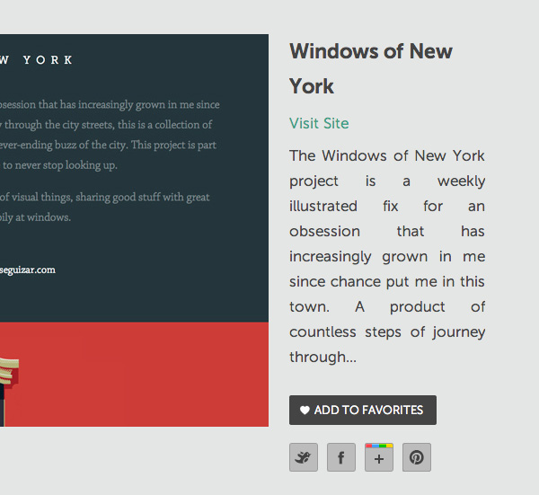

Slide 55
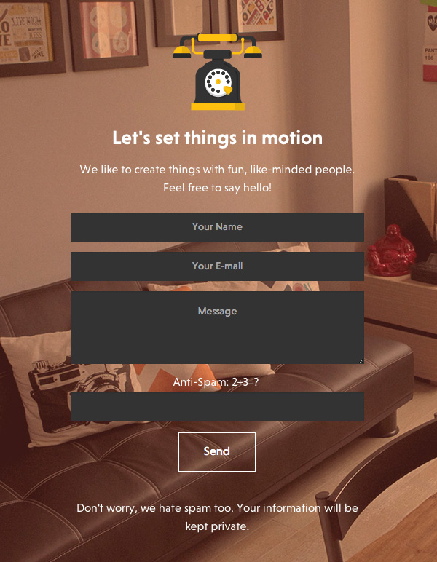

Slide 56
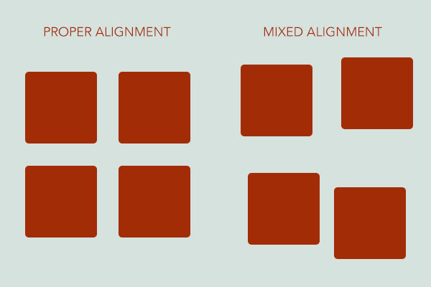

Slide 57
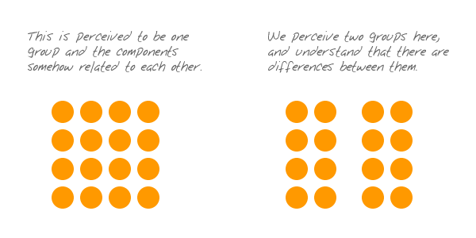
Grouping
The principle of proximity states that things that are close together appear to be more related than things that are spaced farther apart.

Slide 58
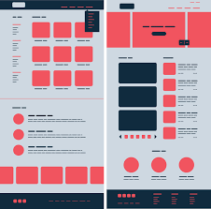

Slide 59
Emphasis
Every design should incorporate a primary element like this, known as a “focal point,” this will serve as the gateway to your composition for viewers.
This is emphasis: when an element naturally becomes dominant in a composition.

Slide 60
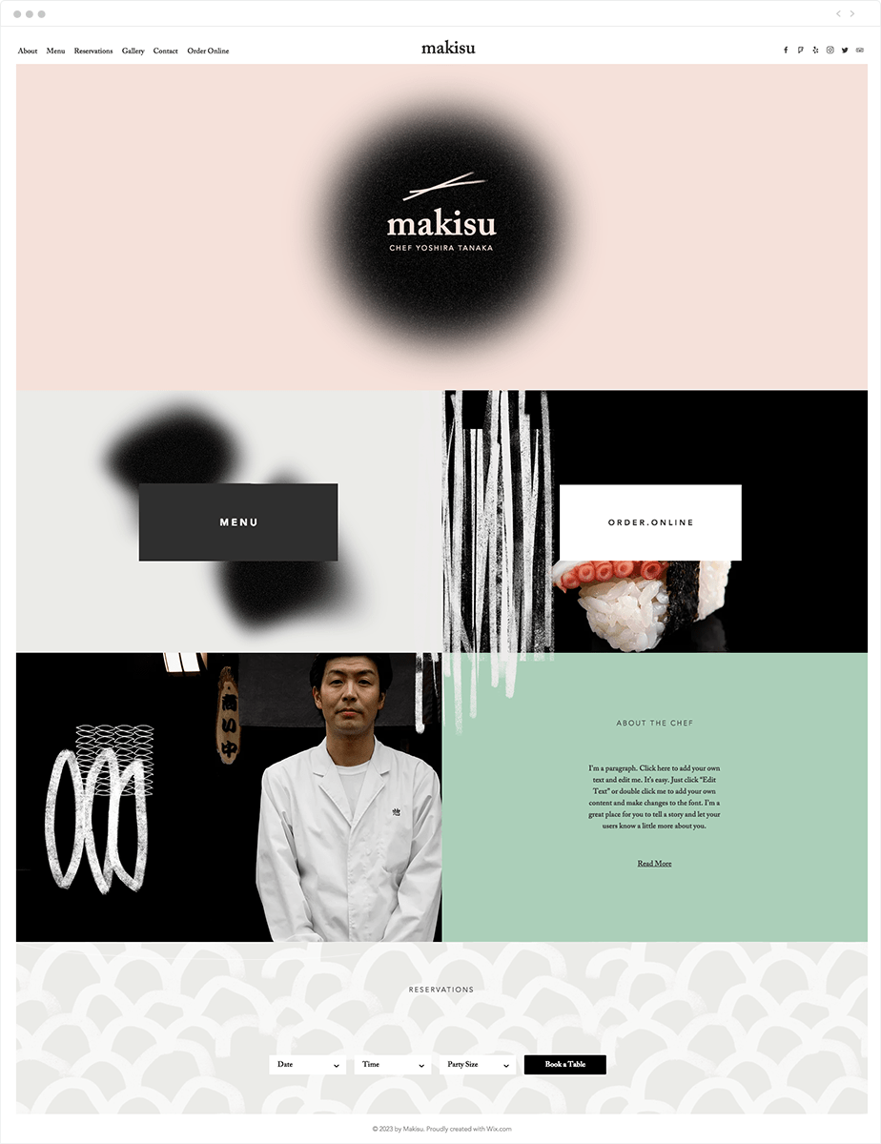

Slide 61
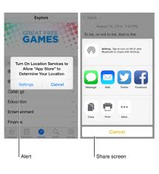
3d touch in iPhone

Slide 62
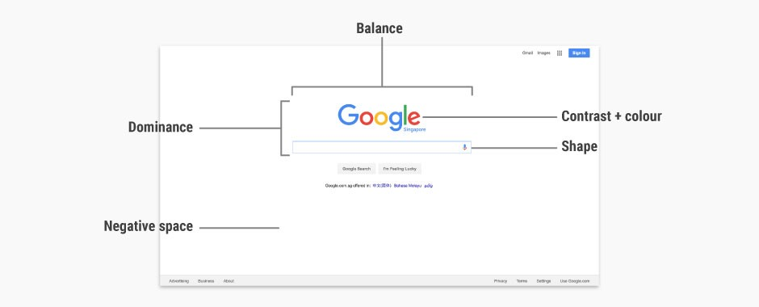

Slide 63
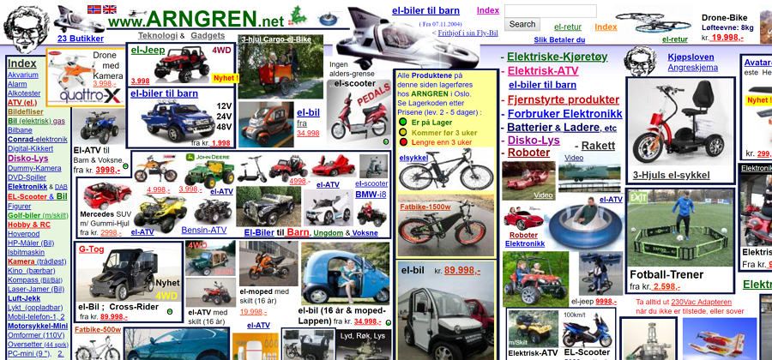
BAD UX Design Examples

Slide 64
What are the problems
The biggest problem is that the website doesn't use a grid.
Unbelievable navigational structure.
Poor layout makes it unreadable.
Random use of colors.

Slide 65
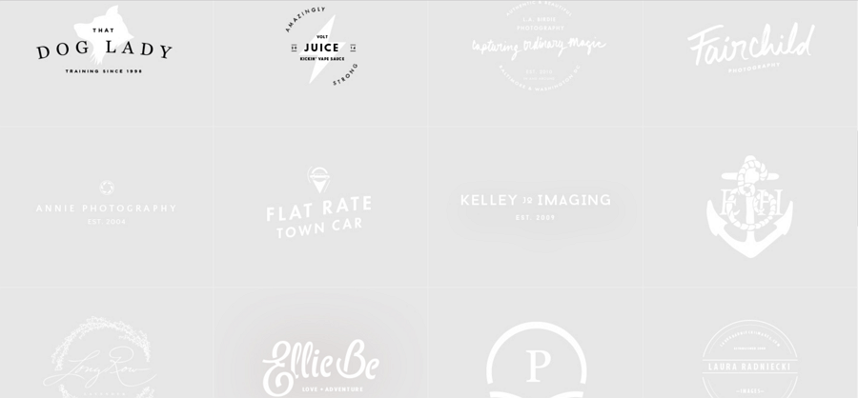

Slide 66
On this site, the background color and text color are pretty much similar, leaving a very weak contrast.
The poor contrast makes the text become blurry to the eye.
Besides, the small font size makes the readability of the text extremely poor.

Slide 67
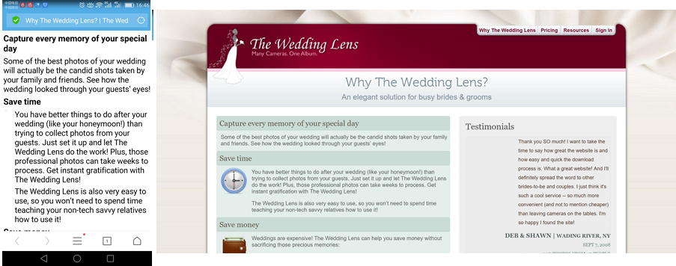

Slide 68
Issues
You should always use a responsive design framework, or adopt other better solutions.
Your web page needs to run on mobile smoothly as it does on the website.
On this site, when loading on the mobile phone, it still shows an entire page with such a poor interface of plaintexts.
It does not have a mobile version to view, so it’s unable to use on the phone.

Slide 69
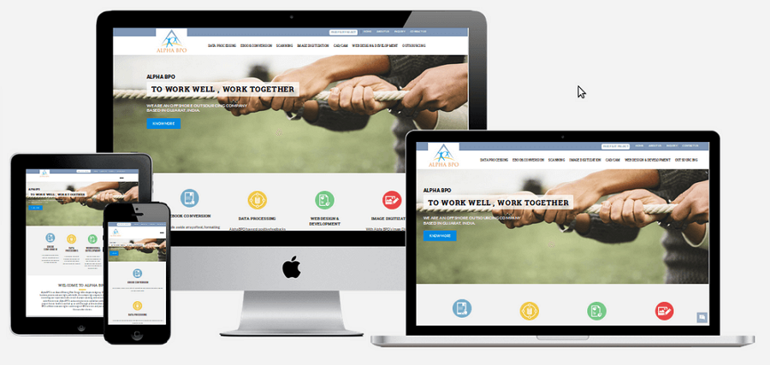

Slide 70
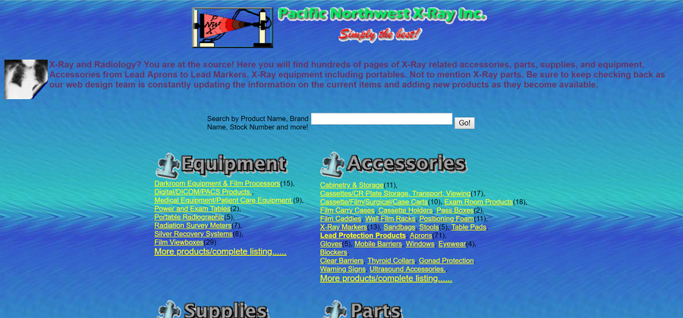

Slide 71
Issues
Contains plenty conflicting colors and text colors, and also mixed with the background color.
All those make it difficult for users to read at all.
Also, the navigation is quite complicated.

Slide 72
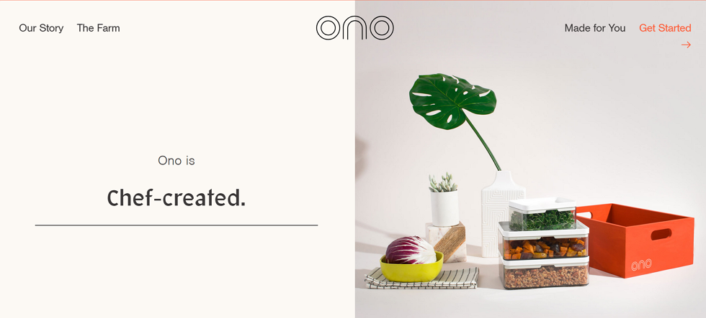

Slide 73
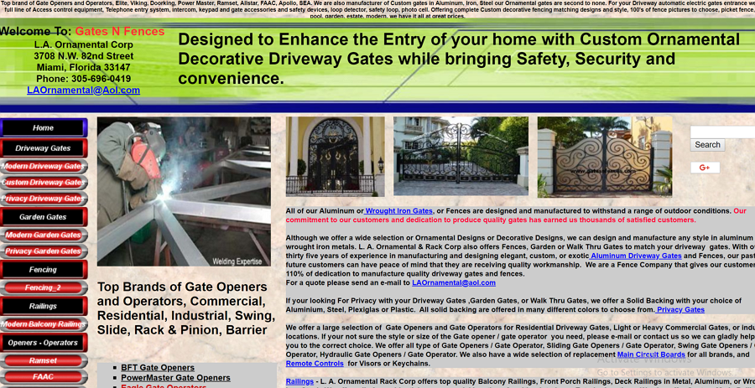

Slide 74
Issues
Poor navigation and operations
The biggest feature of navigation for a website is self-evident.
When a user logs onto your website, he/she should understand what they can do next and what actions to take to reach their destination.
The navigation must be eye-catching and should often be at the top of the page.
Do not try to design a navigation like this site.
It only makes the user more confused.

Slide 75
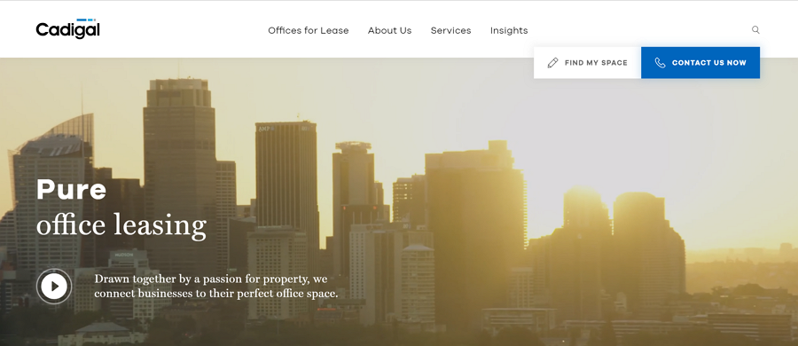

Slide 76
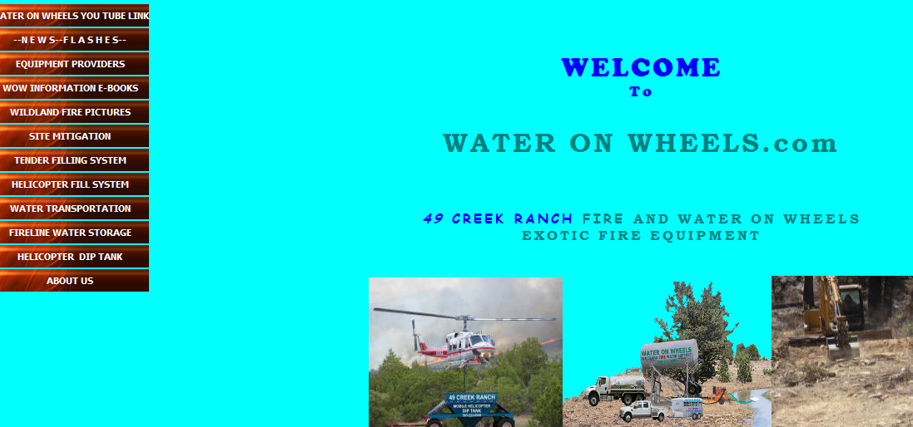

Slide 77
Issues
Inconsistent style
If you want to keep the page smooth and concise, then do not use too much element of different styles.
On this site, the text area uses contrasting colors and different font sizes to highlight the info.
But the text on the second level also uses a highlight blue color, which in fact breaks the unity and balanced hierarchical interface.
Unity is crucial to the overall beauty and fluency of the web interface

Slide 78
Resources
https://www.wix.com/blog/2018/07/7-principles-of-design-websites/
Optimize Images for the Web Using Pixlr
https://www.youtube.com/watch?v=5Eg1IX6vBYc
Design Logo
https://www.wix.com/blog/2018/02/how-to-design-logo-guide/

